Slide 1




AntarVaani
Let your inner voice be heard...
March 09, 2025

Slide 2
Team Members
Shamik Mandal (3rd Year,CSE-AI, IEM)
Roushan Paul (3rd Year, CSE, IEM )
Sheetam Coondoo (4th Year,IT, BPPIEM )
Saptarshi Bannerjee (3rd Year, ECE, IEM)
Koyelisha Khan (3rd Year, CSE, IEM)

Slide 3


Introduction
AntarVaani is an AI-powered mental health chatbot designed to assist users in understanding and addressing their mental health needs. This project aims to provide personalized mental health assessments, therapist recommendations, and real-time AI conversations to users seeking emotional support.

Slide 4
Key Features
Mental Health Assessment: Users answer 18 questions, and the system generates personalized mental health insights.
AI Chatbot: Built using LangChain, Groq API (LLaMA 3), and ChromaDB to provide empathetic responses and mental health guidance.
Therapist Recommendations: Suggests suitable therapists based on the user's assessment and therapist data from a CSV file.
PDF Document Processing: Uses LangChain DirectoryLoader to process PDF files and generate context-based information.
User-Friendly Interface: Developed with Gradio for easy chatbot interaction and report generation.

Slide 5
Technology Used
Frontend: Gradio (for chatbot UI)
Backend: Python, LangChain, HuggingFace Embeddings, ChromaDB, Groq API
File Processing: PDF documents, CSV files (for therapist data)
AI Model: LLaMA 3.3 70B Versatile (by Groq API)

Slide 6
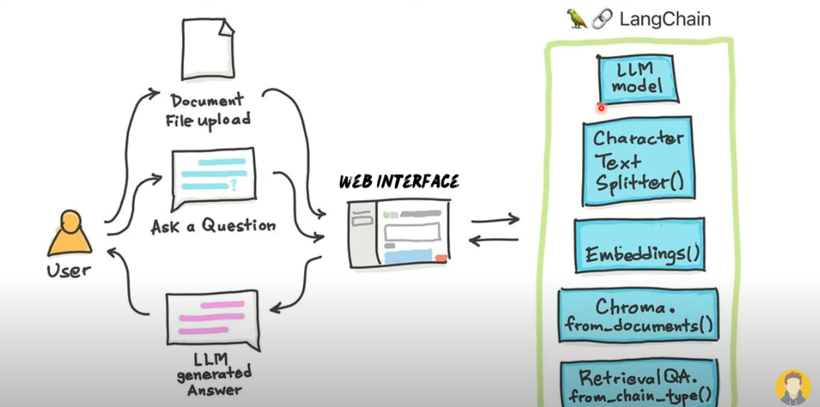
How things work

Slide 7
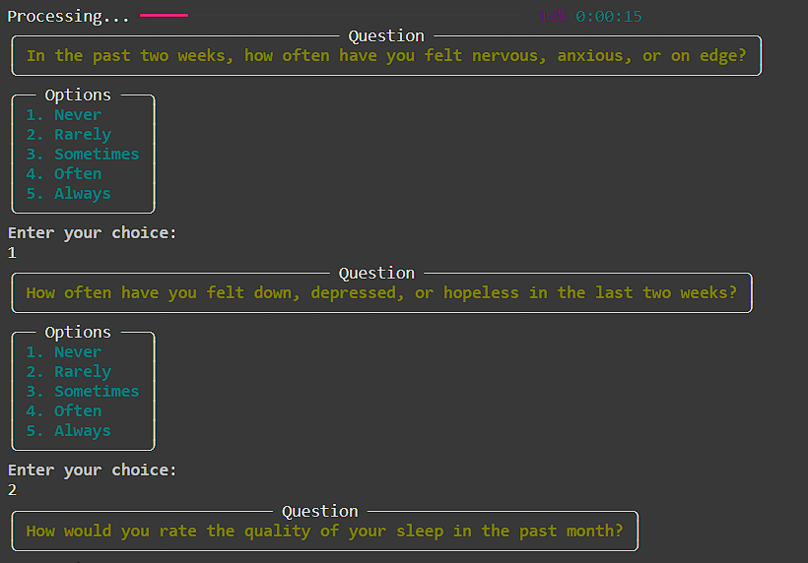
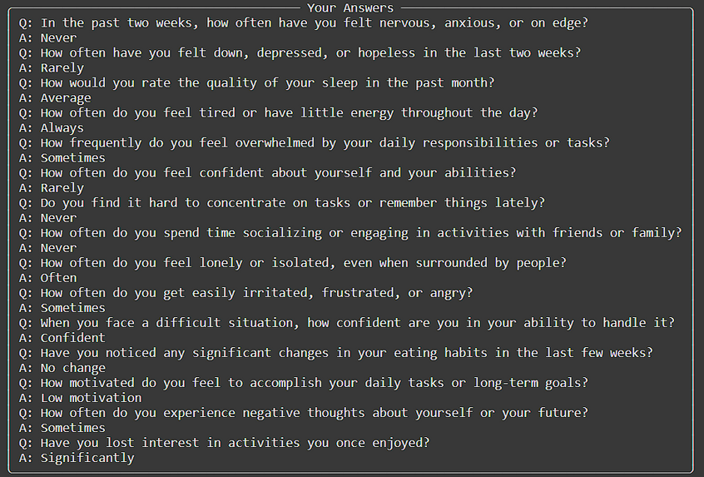
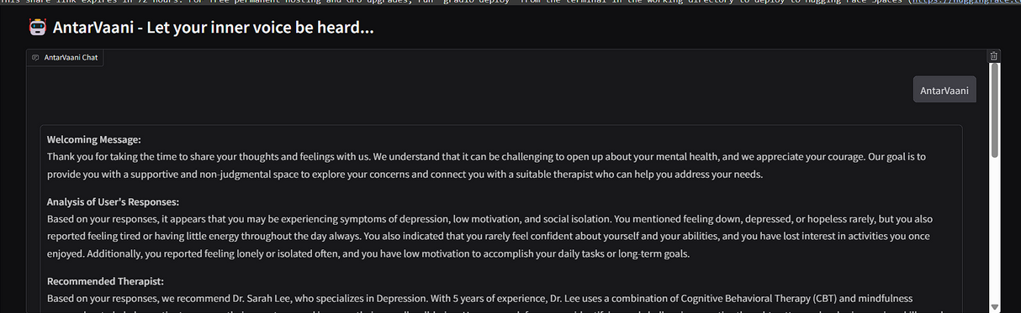
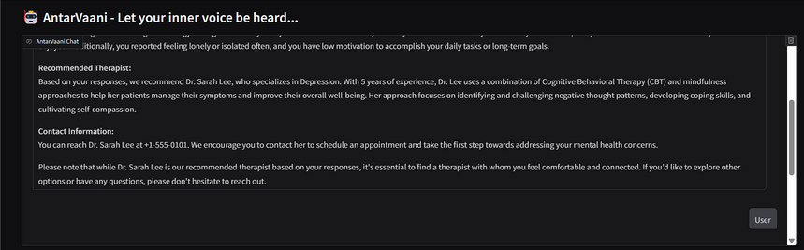
Chatbot

Slide 8
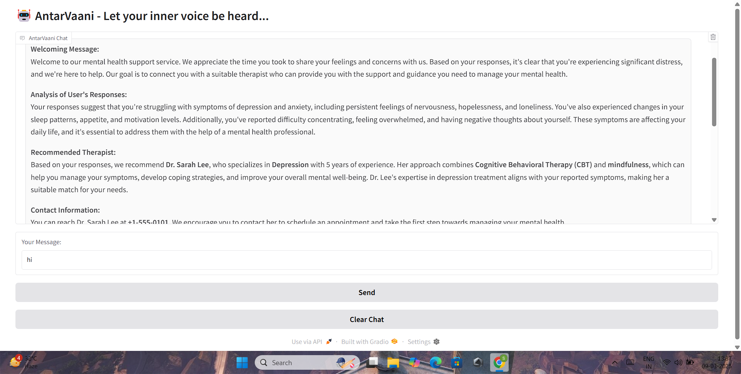

Slide 9
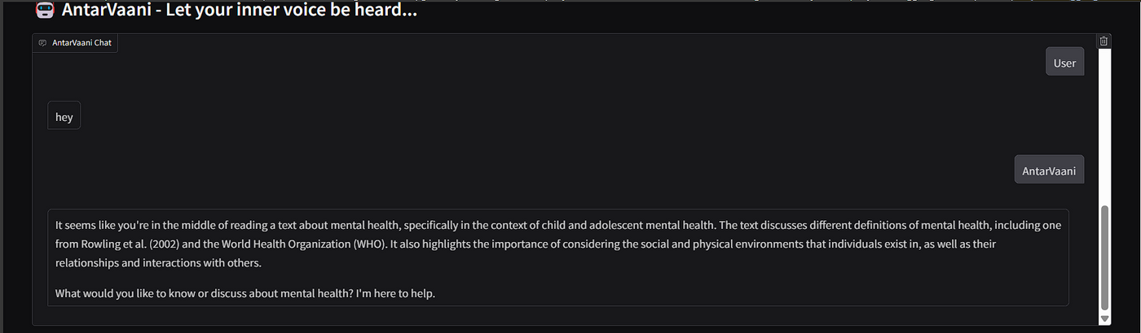
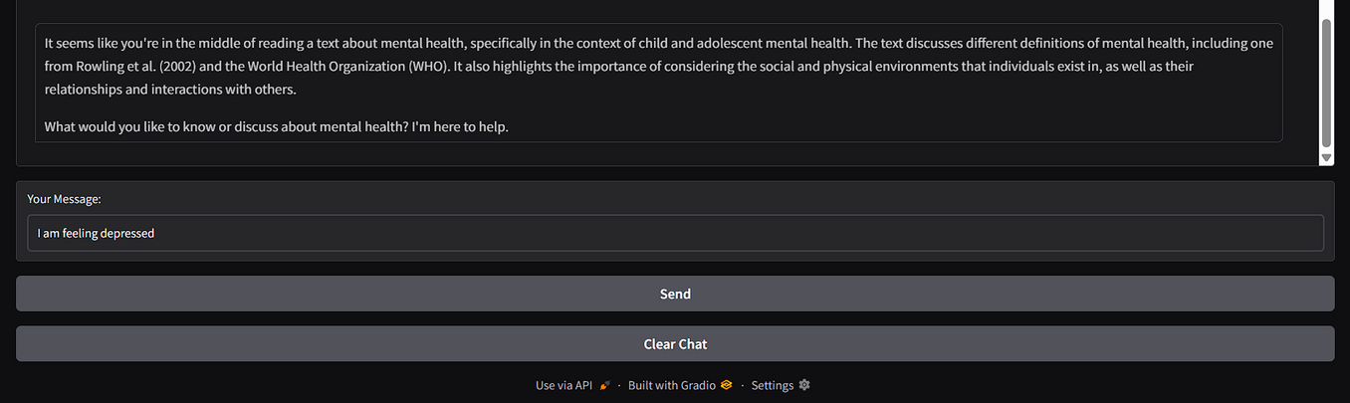
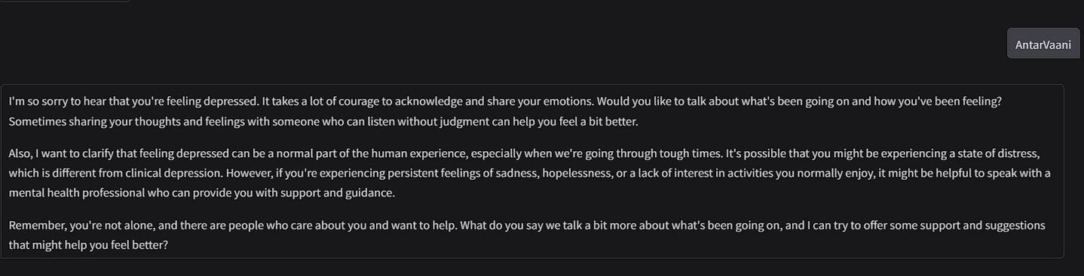

Slide 10

Future Scope
In the future, we plan to integrate this AI-powered chatbot with a dedicated React.js frontend web application to enhance user experience. This integration will:
Provide a modern, responsive UI for users to take mental health assessments and interact with the chatbot.
Offer real-time chat support, making communication more natural and accessible.
Seamlessly connect with ChromaDB and LangChain API to fetch relevant insights from PDFs and provide contextual answers.
Display recommended therapists visually with detailed profiles and contact options.

